Slide 1
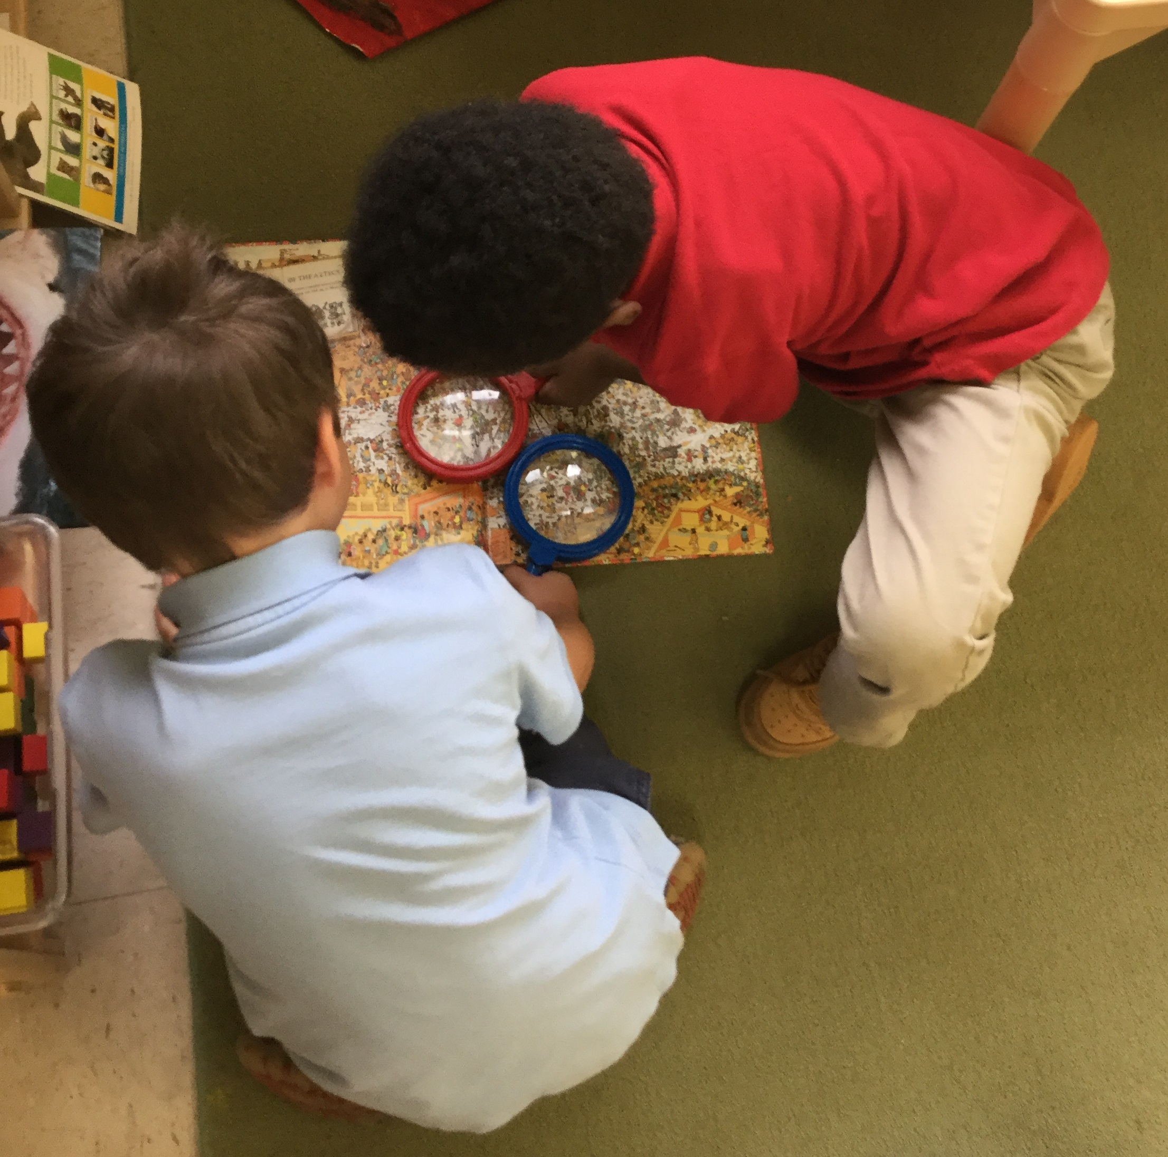
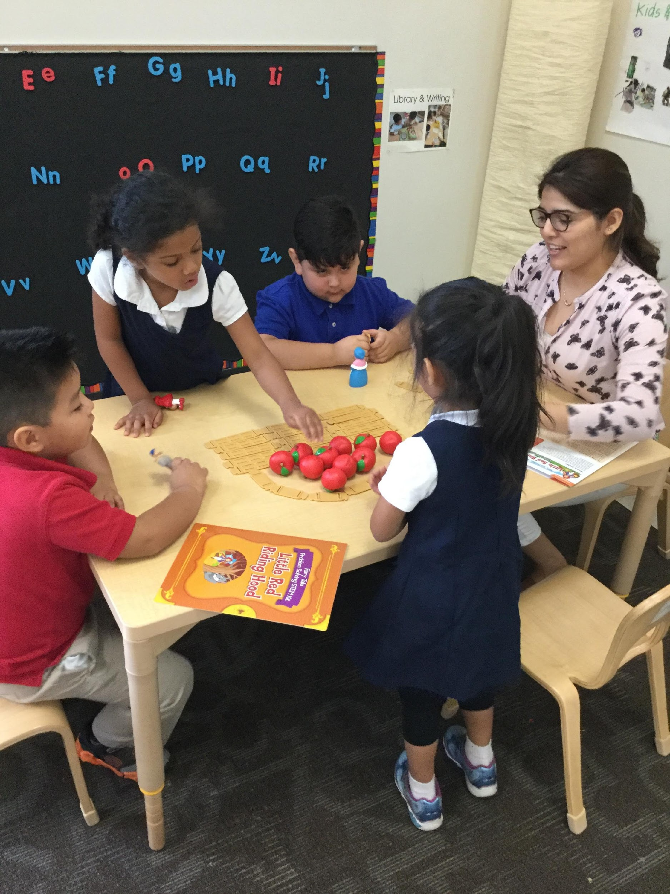
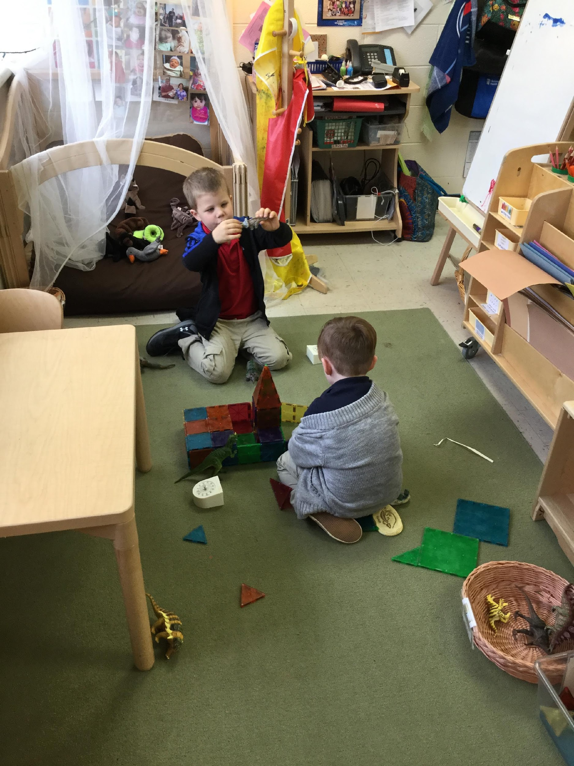
Reducing Time Spent in Transition
CHALK PROFESSIONAL DEVELOPMENT SERIES
Notes:
-swap these photos for some from ELC classrooms

Slide 2
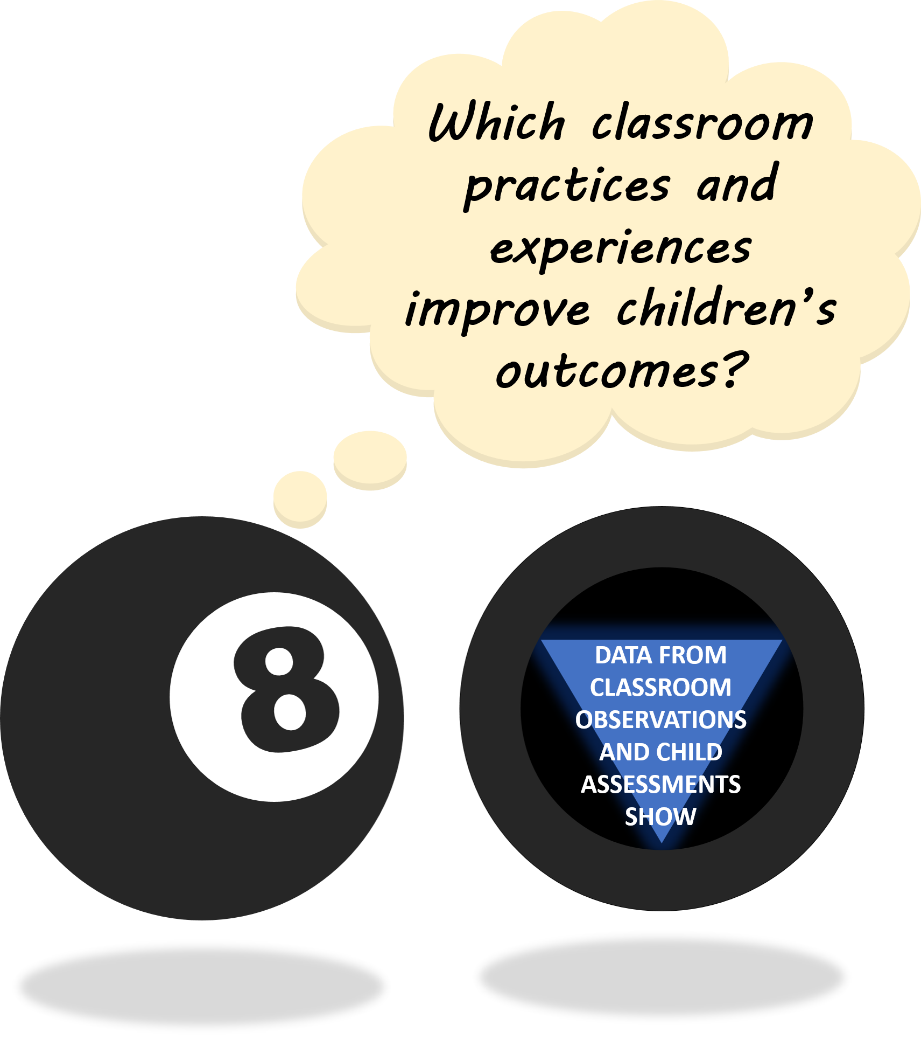
THE “MAGIC 8” CLASSROOM PRACTICES
Reduce time spent in transition
Improving level of instruction
Creating a positive climate
Increasing teacher listening to children
Planning sequential activities
Promoting associative and cooperative interactions
Fostering high levels of engagement
Providing math opportunities
★ 2017-18 Initiative: Focus on Literacy ★

Slide 3

WHAT IS A TRANSITION?
A “transition” is a prolonged period in which most of the class is
not involved in a learning opportunity.
Breaks when one activity has ended but another has not yet begun
Interruptions of activities that result from teachers gathering materials or correcting behavior
Times that children can’t begin an activity because they are awaiting instructions or materials
Times that children are moving to a new location (i.e., going outside, lining up for restroom breaks)
DISCUSSION POINT:
Which types of transitions
can you control?
Notes:
Purposely avoided use of PRI definitions for coding (75%, more than 1 minute)—it might be counterproductive for teachers to focus on these distinctions right now. Goal here is for them to be thoughtful about how children are spending time in the classroom, rather than for them to try to “game” our coding system.

Slide 4



BENEFITS OF REDUCED TRANSITION TIME
Reducing time spent in transition leads to:
Fewer instances of problem behavior
Higher levels of involvement in learning
More time available for instruction
Data collected in MNPS Early Learning Center classrooms showed a strong relationship between time spent in instructional activities and children’s achievement gains.
Some transition time during the day is both normal and necessary–
the goals for reducing transitions should be to:
1) decrease the overall “wait time” between activities whenever possible
2) incorporate engaging instructional content when a transition is unavoidable
These goals can be accomplished consistently via thoughtful planning and reflection…
Make a plan
Review expectations
Incorporate learning activities
Support individual students
Debrief

Slide 5
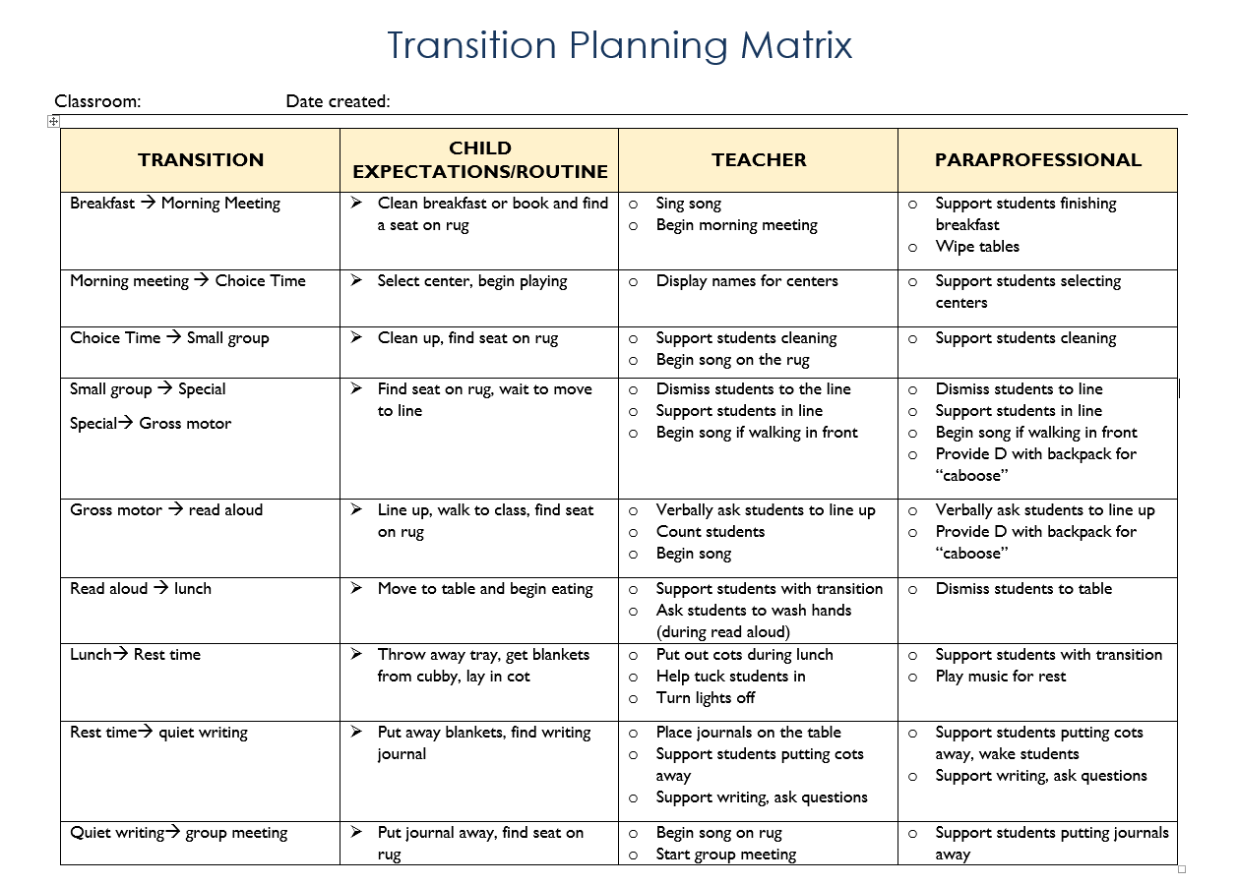


1. MAKE A PLAN
Use a tool for mapping
Child expectations/routine
Lead Teacher role
Paraprofessional role
…to plan for each major transition throughout the day!
Questions to Consider:
T R A N S I T I O N
How can you and your paraprofessional work together?
What instructional activities can you incorporate?
Are there students who need additional support?
Can you stagger dismissal from certain activities (e.g., block center cleans up first…)?
Notes:
-Emphasize how lucky to have EA/co-teacher to help support
-

Slide 6


2. REVIEW EXPECTATIONS & CUES
Establish expectations for moving from one activity to another
Model, practice, and praise appropriate cleanup behaviors—especially at the beginning of the year
Example cues: timers and alarms, verbal reminders, peer schedule helpers, specific songs
Revisit these procedures periodically
Check for understanding
Call on children to summarize expectations in their own words
Act out a scenario in which you are cleaning up your area while thinking aloud and allowing children to help you problem solve.
Hmm, I can’t remember what I’m supposed to do when the 5 minute timer goes off…
DISCUSSION POINT:
When do you find it helpful to reset/review expectations as a class?
Notes:
Emphasize that reviewing procedures doesn’t need to take up a great deal of time!
Suggested times to reset/review transition expectations: after a holiday/school break, introduction of new Creative Curriculum studies and center activities, adjustments in daily schedule
Try getting parts of the routine wrong on purpose—children will LOVE to “correct” you!

Slide 7
3. SUPPORT INDIVIDUAL STUDENTS
Children who may need additional support…
Those with IEPs (or in progress)
Those who tend to finish early (or late)
Those who have trouble understanding verbal instructions
Translate cues into native language or sign language
Ask paraprofessional to help support individual child needs
Use visuals so students know what to expect
Involve peers to help with transitions
DISCUSSION POINT:
Which strategies have
worked well in your classroom?
Notes:
*any of these strategies could be beneficial for all students
-have teachers share support strategies that have worked well for them

Slide 8


4. INCORPORATE LEARNING ACTIVITIES
Songs & Fingerplays
Try choosing one with Math or Literacy content
“Move like a…” (e.g., snake, kangaroo, mime)
Find shapes, colors, or numbers while walking down the hallway
Use Creative Curriculum Mighty Minutes®
Plan to begin the next activity as soon as a few students are ready!
DISCUSSION POINT:
What is your favorite transition song or activity?
Notes:
-Don’t let activities prolong transition!
-beginning next activity ASAP gives children incentive to finish cleaning up/moving from next activity and join right in

Slide 9

5. DEBRIEF (AND CELEBRATE!)
I love how Jimmy came straight to the rug and showed me he was ready to learn.
Give students positive, specific feedback about what went well during the transition
Check in with your paraprofessional at the end of the day
Questions to Consider:
Do I spend a lot of time addressing behavior during transitions?
Do children who finish transitioning first seem bored while they wait for their peers?
Do we need to reset or review?
Are there particular transitions that are stressful for me or for my students?
I saw Effie, Deana, and Curtis helping their friends clean up another center!
Don’t be afraid to adjust parts of the
routine that aren’t going smoothly!
Notes:
Mention link to positive climate

Slide 10

SPECIAL THANKS & ADDITIONAL RESOURCES
We are grateful to the following MNPS Pre-K Instructional Coaches and Multi-Classroom Leaders for their invaluable feedback in developing these materials:
SeTara DeThrow
Carrie Head
Susan McClain
Stephanie Mullins
Holly Stone
Ashley Aldridge Wilson
Rhiannon Wilson
https://my.vanderbilt.edu/mnpspartnership/

Slide 11
INDIVIDUAL IMAGE SOURCES
FREQUENTLY USED IMAGES*
ADDITIONAL IMAGE SOURCES
Lightbulb | myiconfinder.com
Designed by Vexels.com:
Hand drawn magnifying glass
Hand drawn bar graph
Pie chart hand drawn doodle
Hand drawn wall clock
Hand drawn cloud bubble
Hand drawn open book
Cog wheel hand drawn icon
Slide 6: Timers | pixabay.com
Slide 8: children dancing | kisspng.com
*These graphics are used as icons throughout the series. For example this lightbulb clipart appears beside most “Discussion Point” questions.

